Slide 1

One Day Networking Programme on Accelerating & Maximizing Practice
Committee for Members in Practice
The Institute of Chartered Accountants of India
(Set up by an Act of Parliament)
CA. Gyan Chandra Misra
Central Council Member, ICAI

Slide 2

Minimum Recommended Scale of Fees for the
Professional Assignments done by the Chartered Accountants

Slide 3
Minimum Recommended Scale of Fees for the Professional Assignments done by the Chartered Accountants (as on 11.02.2020)
ICAI
The Committee for Members in Practice (CMP) of ICAI as a part of its commitment to strengthen the Practitioners had Revised Minimum Recommended Scale of Fees for the professional assignments done by the members of ICAI. The recommendation is about the fee to be charged as per the work performed for various professional assignments. The fee has been recommended separately for Class A, Class B and Class C cities.
The following are the Professional Assignments covered in the Minimum Recommended Scale of Fees :
1) ADVISING ON DRAFTING OF DEEDS/AGREEMENTS
2) INCOME TAX: Filling of Forms etc. (Quarterly Fees) (Quarterly Fees) (Quarterly Fees, Filling of TDS/TCS Return (per Form), Filling of Form No. 15-H/G, Form No. 49-A/49-B, Any other Forms filed, Obtaining Certificate from Income, Filling of Appeals, Attending Scrutiny Assessment/Appeal, Attending for Rectifications, Income Tax Survey, T.D.S. Survey, Income Tax Search and Seizure, EE of Return of Income, Filling of Return of Income with detailed Capital Gain working

Slide 4
Minimum Recommended Scale of Fees for the Professional Assignments done by the Chartered Accountants (as on 11.02.2020)
ICAI
3) CHARITABLE TRUST
4) COMPANY LAW AND LLP WORK
5) AUDIT AND OTHER ASSIGNMENTS - Rate per day would depend on the complexity of the work and the number of days spent by each person (Principal, Qualified Assistants, Semi Qualified Assistants, Other Assistants)
6) INVESTIGATION, MANAGEMENT SERVICES OR SPECIAL ASSIGNMENTS
7) CERTIFICATION WORK - Issuing Certificates under the Income Tax Act i.e. U/s 80IA/80IB/10 A/10B & other Certificates
8) RERA
9) CONSULTATION & ARBITRATION
10) NBFC/RBI MATTERS
11) GST
12) FEMA MATTERS
13) PROJECT FINANCING (Preparation of CMA data, Services relating to Financial sector)
14) ACCOUNTANCY SERVICES (Book Keeping and the preparation of financial statements & Other Services)
The Fees are Recommendatory in nature

Slide 5
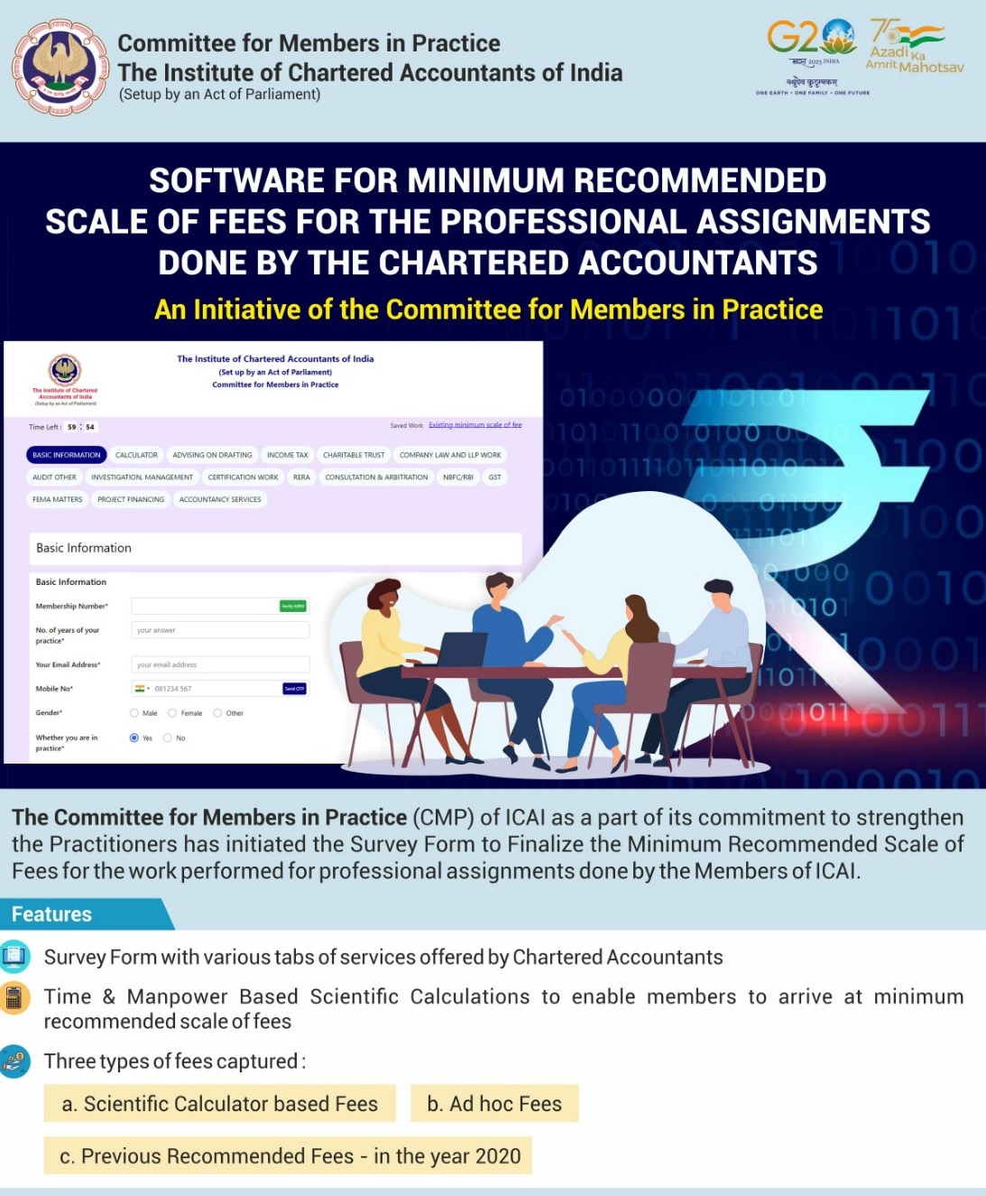

    Software for Minimum Recommended Scale of Fees for the Professional Assignments done by Chartered Accountants
ICAI
Software for Finalization of Minimum Recommended Scale of Fee
https://minrecfees.icai.org/

Slide 6

Tender Monitoring Directorate: Ensuring Fairness in Professional Service Tenders
ICAI
Introduction
The Institute of Chartered Accountants of India (ICAI) has formed a new Directorate called Tender Monitoring Directorate to give focused attention to tenders for professional services.
The Directorate comprises 17 members of Council and 18 special invitees from outside the Council, and an agency has been appointed by ICAI to track all tenders for professional services published across India.

Slide 7
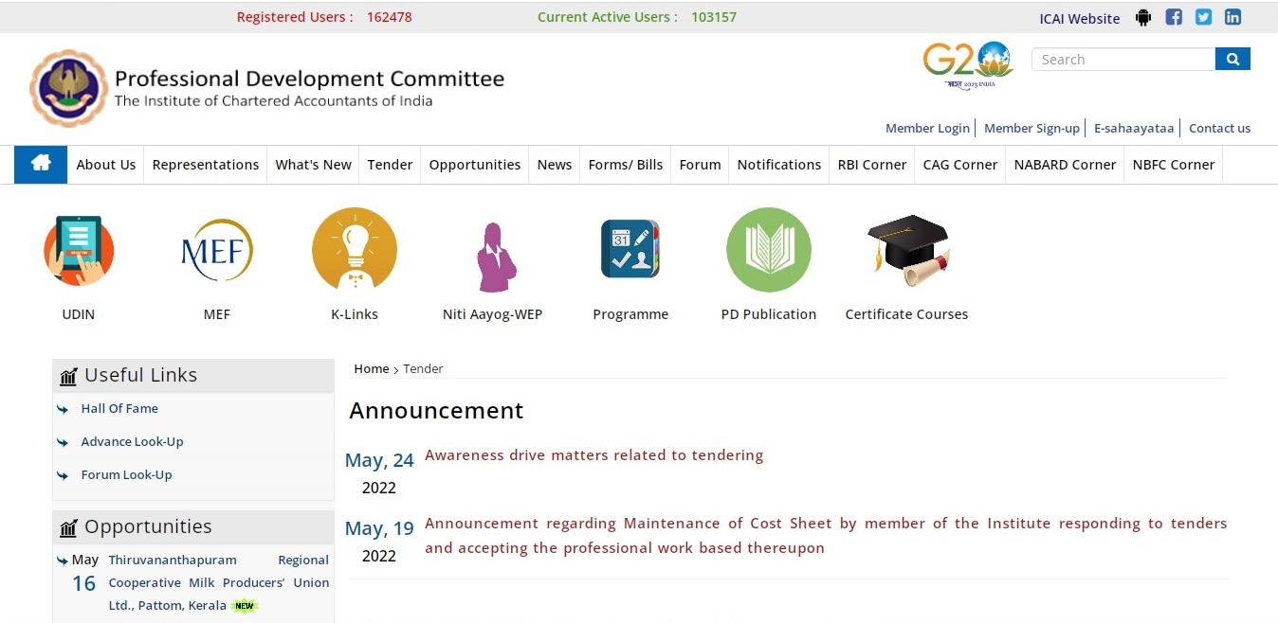

ICAI
Professional Development Committee Portal
All tenders for professional services that are tracked by the agency and scrutinized by the TMD Secretariat are posted on the PD Portal - https://www.pdicai.org under the head 'Opportunities'.
This portal enables members of the ICAI to respond to tenders which are open to other professionals as well.

Slide 8

ICAI
Fairness in Tenders
If the ICAI notices any unfairness, restrictive conditions, conflict, or non-prescription of minimum fees in case of areas exclusive to Chartered Accountants such as audit and attestation services, they make representations to the organization and advise them to modify their tender.
This ensures that all tenders are fair and transparent, allowing members of the ICAI to compete on an equal footing with other professionals.

Slide 9

ICAI
Role of Tender Monitoring Directorate
The Tender Monitoring Directorate represents to the tenderers calling upon them to –
Follow ICAI guidelines
Keep unrestrictive eligibility conditions
Adopt Fixed Cost or Quality & Cost based Selection method
Approach PD Committee for panel
Tenderers for audit services are no longer required to go by Least cost method, as per revised Manual issued by Ministry of Finance, Government of India.
Members are educated about adherence to Code of Ethics in the matter of responding to tenders

Slide 10

ICAI
Benefits for Members
Prescription of minimum fees for exclusive areas and demand of cost sheet from low bidders, ensures that price commanded by members is high, and at the same time, quality of work is also maintained.

Slide 11

ICAI
Importance of Tender Monitoring Directorate
Fairness and transparency in tendering process
Level playing field to bidders
Reasonable fees to members
Maintenance of Quality of work

Slide 12
ICAI
Various methods of Selection of bidders
The tenderers generally resort to Least Cost method, which ICAI opposes and represents.
ICAI had been representing to Government against Least Cost Method. Ministry of Finance, Government of India has taken out “audit” from routine nature of services and has advised Central Government and its Departments that they need not go for Least Cost method for audit service.
ICAI insists for Fixed Cost method or Quality & Cost based selection.

Slide 13
Guidance on Tenders
2009
It is not prohibited to respond to tenders of professional Assignments
Revised code
Guidance in view of 7.4.2016 Guideline on Tenders No. 1-A(7)/03/2016 - a member of the Institute in practice shall not respond to any tender issued by an organization or user of professional services in areas of services which are exclusively reserved for chartered accountants, such as audit and attestation services. However, such restriction shall not be applicable where minimum fee of the assignment is prescribed in the tender document itself or where the areas are open to other professionals along with the Chartered Accountants.
FAQs on tenders can be seen in ICAI’s publication – Tendering of Professional Services - https://www.pdicai.org/Docs/Publications/Tendering%20of%20Professional%20Services-19-3-22_213202215925537.pdf
Exorbitant EMD – ESB may look in case to case basis

Slide 14

ICAI
Honorarium Structure of TAQRB & FRRB
TAQRB
An honorarium of Rs. 10,000/- per report along with Rs. 500/- for printing charges (excluding GST) are payable to the Technical Reviewers empanelled with the Board.
An honorarium of Rs. 5,000/- per report along with Rs. 500/- for printing charges (excluding GST) are payable to the members of the Review Groups (other than the ICAI’s Central Council Members, Regional Council Members and the Members of the Branch level management committee).
FRRB
Honorarium of Rs 20, 000/- Per case is paid to technical reviewers empanelled with the Board.

Slide 15

CODE OF ETHICS – SIGNIFICANT CHANGES

Slide 16
Certain Revised Provisions
12th edition of Code of Ethics (in three Volumes) was applicable from 1st July, 2020
However, the following provisions in Volume-I were deferred due to situation prevailing due to Covid-19:-
1. Fees - Relative Size [Paragraphs 410.3 to R410.6]
2. Tax Services to Audit Clients [Subsection 604]
Deferred provisions have been made applicable w.e.f 1st October , 2022 vide Announcement dt. 29th September , 2022 with certain amendments.

Slide 17
VOLUME - I

Slide 18
Changes in Professional Appointment (Section 320)
New provisions in 2019 Code
Code of Ethics, 2019 (Volume-I) contains detailed guidance on client and engagement acceptance / changes in professional appointment
ICAI “Know Your Client” (KYC) Guidelines incorporated – which are mandatory for all attest functions w.e.f 1.1.2017
In case of change of appointment, if unable to communicate with the predecessor accountant, the proposed accountant shall take other reasonable steps to obtain information about any possible threats.
Communication requirements in case of Audit and Non-Audit Assignments differentiated
Duty of predecessor accountant to respond to communication (against the existing Code which is silent on this issue). He shall:-
Comply with relevant laws governing the request; and
Provide any information honestly and unambiguously.

Slide 19
Contingent Fees (Sections 330, 410.9, 905.6)
Code of Ethics, 2009 (Paragraph 290.197) - fees based on percentage of profits or contingent upon the findings, or results of such work not allowed (as per Clause 10 of Part-I of First Schedule to CA Act) except as permitted under Regulation 192
Code of Ethics, 2019 (Volume – I) mentions general description of Contingent fees and the general prohibition
Regulation 192 reproduced – further , the activities where Council has permitted Contingent fees under 192 (h) i.e “any other service or audit as may be decided by the Council” :-
Charging of Fees by Members enrolled as Insolvency professional rendered either individually or as an entity under Insolvency and Bankruptcy Code, 2016 and rules made thereunder.
Fee for rendering Non-assurance services to non-audit clients

Slide 20
Commentary Under Clauses (3) and (4) – Part - I, First Schedule
Referral fees amongst members
2009 - Silent
New - Permitted under commentary to Clause (3)
-------------------------------------------------------------
MDPs
Despite Regulations 53 A(3) and 53B, MDPs not allowed till Regulators of other professions also allow , and ICAI issues modalities
------------------------------------------------------------
No equivalent of Director Simplicitor in partnerships
A member in practice cannot become a partner/ designated partner (non-working and non-remuneration drawing) in an LLP not carrying out professional work.

Slide 21
Charging Fees on Percentage Basis

Slide 22




CHARGING FEES ON PERCENTAGE BASIS
Clause (10) Of Part-I Of The First Schedule Of The Chartered Accountants Act, 1949 states that a member shall be deemed to be guilty of misconduct rendering him unfit to be a member of the institute if he —
“Charges or offers to charge, accepts or offers to accept in respect of any professional employment, fees which are based on a percentage of profits, or which are contingent upon the findings, or results of such employment, except as permitted under any regulation made under the act.”

Slide 23
IMPORTANT POINTS
Fees cannot be charged on the basis percentage of profits.
Fees cannot be charged based on findings or results of any contingency in Professional work.
Agreeing to charge or accept fees on a percentage basis or contingent upon findings or results also would become professional misconduct.

Slide 24
The Council has under Regulation 192 prescribed exceptions to the general rule of bar on charging fee on percentage basis.
Exceptions – Regulation 192 of Chartered Accountants Regulation 1988-
in the case of a receiver or a liquidator, the fees may be based on a percentage of the realization or disbursement of the assets.
in the case of an auditor of a co-operative society, the fees may be based on a percentage of the paid-up capital or the working capital or the gross or net income or profits.
in the case of a valuer for the purposes of direct taxes and duties, the fees may be based on a percentage of the value of the property valued.
in the case of certain management consultancy services as may be decided by the resolution of the Council from time to time, the fees may be based on a percentage basis which may be contingent upon the findings, or results of such work.
in the case of certain fundraising services, the fees may be based on a percentage of the fund raised.
in the case of debt recovery services, the fees may be based on a percentage of the debt recovered.
in the case of services related to cost optimization, the fees may be based on a percentage of the benefit derived.
Any other service or audit as may be decided by the Council.
Note: Following activities have been decided by the Council under “h” above:-
- Acting as Insolvency Professional.
- Non-Assurance Services to Non-Audit Clients.

Slide 25


Thank You
The Institute of Chartered Accountants of India
(Set up by an Act of Parliament)

